Slide 1


Mini Project Final Presentation
SecureAccess: Bank Locker Security with Facial Recognition Technology
Team Members:
Lima Lolita D’Souza - 4SF21CD013
Adithi - 4SF21CD002
Nihara - 4SF21CD018
Mayur PS – 4SF21CD016
Under the Guidance of:
Dr. Navaneeth Bhaskar
Associate Professor
CSE(DS)/ISE, SCEM
Department of Computer Science and Engineering (Data Science)

Slide 2
Contents
Contents
Introduction
Problem Statement and Description
Objectives
Proposed Methodology
Outcome of the work
Scope and Future work
Conclusion
References

Slide 3
Introduction
Traditional methods of authentication, reliant on physical tokens and PINs, are proving to be insufficient in meeting contemporary standards of security.
Addressing the need for advanced access control in banking security.
Integrating facial recognition technology for bank locker security.
The primary objective of the Real-Time Bank Locker Access Authentication System is to establish a secure, user-friendly, and efficient means of accessing bank lockers.
The significance of this project lies not only in its potential to reshape access control standards within the banking sector but also as a model for secure authentication systems across diverse domains
Data Collection: Gather diverse facial images
Face Encoding: Convert features into numerical representations
Face Enrollment: Capture and encode images of authorized individuals
Face Recognition: Compare face embeddings to determine identity
Deployment and Integration: Deploy system into bank security infrastructure
Maintenance and Monitoring: Regular maintenance and monitoring practices

Slide 4
Problem Statement and Description
In the rapidly evolving landscape of banking security, traditional authentication methods such as Personal Identification Numbers (PINs) and access cards have become increasingly vulnerable to sophisticated cyber threats.
Conventional methods often burden users with the need to remember complex codes or carry physical tokens, creating a potential for human error
A secure bank locker authentication system employing facial recognition technology to verify authorized users.
The objective is to enhance security measures within banking facilities by implementing an accurate and efficient authentication method.
The system will grant access to bank lockers solely to individuals whose facial features match those of authorized users, thereby mitigating unauthorized access and ensuring the protection of valuable assets stored within the lockers.

Slide 5
Objectives
Design and implement a facial recognition system for bank locker access control.
Create a user-friendly interface for authorized personnel dataset management.
Enhance user experience and convenience.
Ensure scalability.

Slide 6
Proposed Methodology
Data Collection: Gather diverse facial images
Face Encoding: Convert features into numerical representations
Face Enrollment: Capture and encode images of authorized individuals
Face Recognition: Compare face embeddings to determine identity
Deployment and Integration: Deploy system into bank security infrastructure
Maintenance and Monitoring: Regular maintenance and monitoring practices

Slide 7
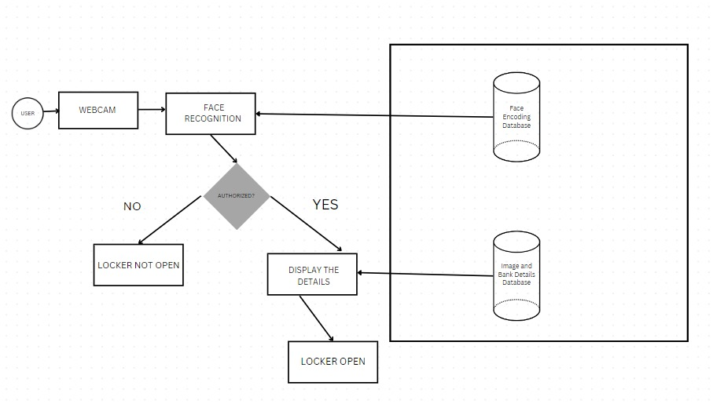
Proposed Methodology
Proposed Methodology
Architucture of the proposed module

Slide 8
Requirements
Components Requirements
High-Resolution Cameras
Processing Unit
Facial Recognition Algorithm
Real-Time Database
User Interface (UI)
Backend System (Python)
Secure User Enrollment Process
System Calibration Mechanism
Monitoring and Update System

Slide 9
Requirements
Software Requirements
Jupyter Notebook
Python Libraries (e.g., OpenCV, NumPy, TensorFlow)
Database Management System (e.g., Firebase)
. Integrated Development Environment (e.g., Visual Studio Code, PyCharm) Development Tools (e.g., HTML, CSS)
Version Control System (e.g., Git)
Text Editor (e.g., Notepad++, Sublime Text)
Communication Tools (e.g., Slack, Microsoft Teams)
Security Tools (e.g., Antivirus software, firewall)
Documentation Tools (e.g., Markdown editors, Google Docs)

Slide 10
Requirements
Hardware Requirements
High-Resolution Cameras
Powerful Processing Unit
Laptops/Computing Devices

Slide 11
Outcome of the work
Prevention of unauthorized access, minimizing theft or security breaches.
User-friendly interface for easy management of authorized personnel datasets.
Improved overall efficiency in access control processes.
Enhanced Security The facial recognition technology fortifies access control, significantly reducing the risk of unauthorized entry.
Real-Time Access: Users can access their bank lockers swiftly, enhancing overall efficiency in banking operations

Slide 12
Scope and Future Work
Continuous Performance Optimization: Regularly assess and optimize the system’s performance to ensure swift and accurate facial recognition. Implement updates to address any emerging security concerns or technological advancement
User Feedback and Iterative Enhancements: Solicit user feedback to identify areas for improvement and implement iterative enhancements. Prioritize user experience to maintain a positive and user-centric authentication process
Collaboration with Financial Technology Innovations: Collaborate with fintech partners and stay engaged with industry innovations to leverage cutting-edge technologies that can further enhance the security and efficiency of the system
Global Implementation: Explore the potential for implementing the system across multiple branches or even on a global scale, considering the unique security and user experience needs of different regions.

Slide 13
Conclusion
Significant advancement in banking security practices.
Leveraging cutting-edge technology for a robust access control solution.
Redefining security standards in the banking sector with AI and facial recognition.
Users could access bank lockers simply by presenting their face to the system, eliminating the need for PINs or access cards
The integration with Firebase real-time database provided a solid foundation for data storage, synchronization, and access log management.
The system demonstrates scalability and adaptability, accommodating diverse banking environments and handling increased user volumes and transaction loads with ease.

Slide 14
References
References
Garg, A., Rouf, R.R., Hafiz, K.N., Sharna, M. and Hasan, N., 2016. Automated detection, locking and hitting a fast moving aerial object by image processing (suitable for guided missile). IOSR Journal of Electronics and Communication Engineering, 11(4), pp.60-68.
Alimi, R., Bakshi, L., Kot, E., Shafir, N., Forte, D. and Sudai, M., 2006. Experimental ballistic improvement in a pure electrothermal (ET) 25-mm gun. IEEE transactions on magnetics, 43(1), pp.284-288.
Jain, A., Arora, D., Bali, R. and Sinha, D., 2021. Secure authentication for banking using face recognition. Journal of Informatics Electrical and Electronics Engineering (JIEEE), 2(2), pp.1-8.

Slide 15
Thank You

